Slide 1

Exploratory Data Analysis on AMCAT Data

Slide 2
A
ABOUT ME:
I have completed my graduation in B.Sc Mathematics, Statistics and Computer Science, which has equipped me wit a diverse skill set essential for Data Science . I'm passionate about Data Science because I enjoy solving problems and uncovering valuable insights from Data . The prospect of diving into large datasets, identifying patterns, and making informed decisions excites me. As a fresher in the field of Data Science, I am motivated to apply my skills and learn continuously in this dynamic field.
LinkedIn:
https://www.linkedin.com/in/fouzia-kouser/
GitHub:
https://github.com/fouzia2305

Slide 3
OBJECTIVE OF PROJECT:
The objective of this project is to conduct a comprehensive Exploratory Data Analysis (EDA) on the A spiring Mind Employment Outcome 2015 (AMEO) dataset . Through this analysis, our goal is to gain deep understanding of the employment outcomes . By exploring variables such as salary, job titles ,job locations ,cognitive skills ,technical skills , personality traits, and demographic features, we aim to uncover valuable insights and patterns hidden within the data.
SUMMARY OF DATA:
The dataset under analysis, sourced from the Aspiring Mind Employment Outcome 2015 (AMEO) focuses on the employment outcomes of engineering graduates . Comprising around 40 independent variables and 4000 data points. Continuous variables such as salary, overall marks in grade 10 and 12 examinations, and scores in various sections of the AMCAT test provide quantitative measures of candidate performance and skills. Categorical variables encompass aspects such as gender, job designation, degree pursued, and specialization, offering qualitative descriptors of candidates and their employment contexts.

Slide 4
DATA CLEANING AND PREPROCESSING:
Loading the Dataset:
Loaded the AMEO dataset provided by Aspiring Minds to initiate the analysis.
Removing Unnecessary Columns:
Dropped irrelevant columns like 'Unnamed: 0', 'ID', 'CollegeID', and 'CollegeCityID' that do not contribute to the analysis.
Handling Date columns:
Replaced ‘present values in 'DOJ' (Date of Joining) and 'DOL' (Date of Leaving)with the current date.
Converted 'DOB' (Date of Birth), 'DOJ', and 'DOL' columns to datetime format for easier manipulation.
Filtering Data:
Filtered out the rows where 'DOL' is before the 'DOJ' to ensure data integrity.

Slide 5
Handling Missing Values:
Replaced missing values denoted by '-1' in numerical columns with NaN.
Replaced missing values denoted by '0' in categorical columns like '10board', '12board', and 'GraduationYear' with NaN.
Replaced missing values in 'JobCity' denoted by '-1' with NaN.
Imputing Missing Values:
Imputed missing values in numerical columns with the mean of respective columns.
Imputed missing values in categorical columns with the mode of respective columns.
Grouping Categorical Variables:
Grouped categorical variables like 'JobCity', '10board', '12board', 'Degree', 'GraduationYear', and others into top 15 groups, with the remaining categories labeled as 'Others’.

Slide 6
Removing certain columns:
Removing 'MechanicalEngg','ElectricalEngg’, 'TelecomEngg’ , 'CivilEngg’ , ’ ElectronicsAndSemicon’ columns as most of the values in these columns contain NaN values.
Identifying Outliers:
Implemented the Interquartile Range (IQR) method to identify outliers in numerical variables.
Calculated the lower and upper bounds, and the count of outliers below and above these bounds for each numerical variable.
Summary Statistics:
Calculated summary statistics such as mean, median, standard deviation, and quartiles for numerical variables.

Slide 7
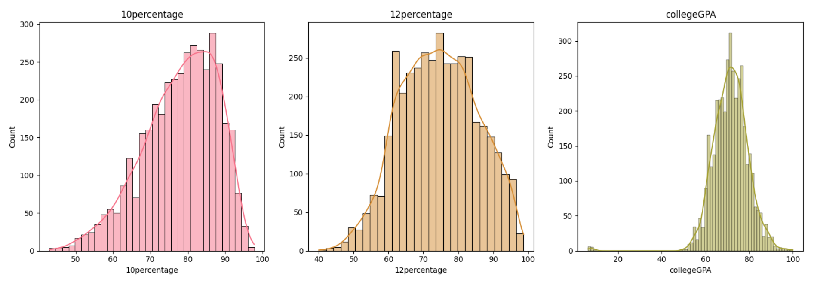
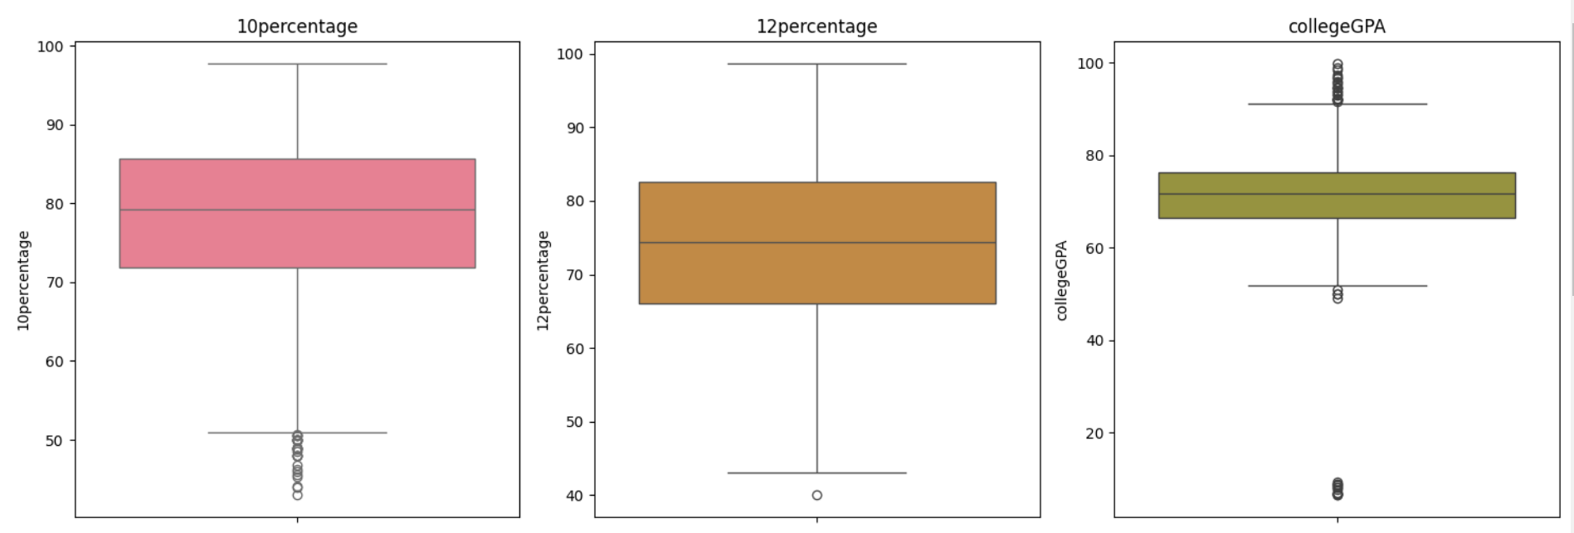
EXPLORATORY DATA ANALYSIS:
UNIVARIATE ANALYSIS ON NUMERICAL COLUMNS:

Slide 8
OBSERVATIONS:
1. 10th Percentage:
The distribution of 10th percentages among engineering graduates ranges from 43% to 98%.
On average , engineering graduates scored 78%.
There are 30 outliers below the lower bound , indicating students with exceptionally low 10th percentages.
2. 12th Percentage:
The engineering graduates have 12th percentages between 40% and 99%.
Only one outlier is observed below the lower bound , suggesting rare instances of exceptionally low 12th percentages .
3. College GPA:
The average college GPA of engineering graduates is around 71%, with a standard deviation of 8%.
There are 16 outliers below the lower bound and 22 outliers above the upper bound, indicating some students with unusually low or high GPAs.

Slide 9
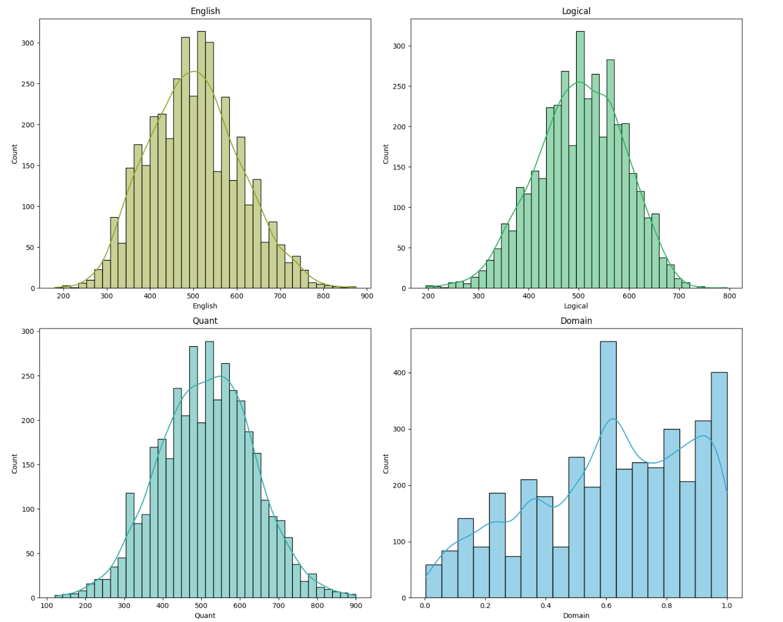
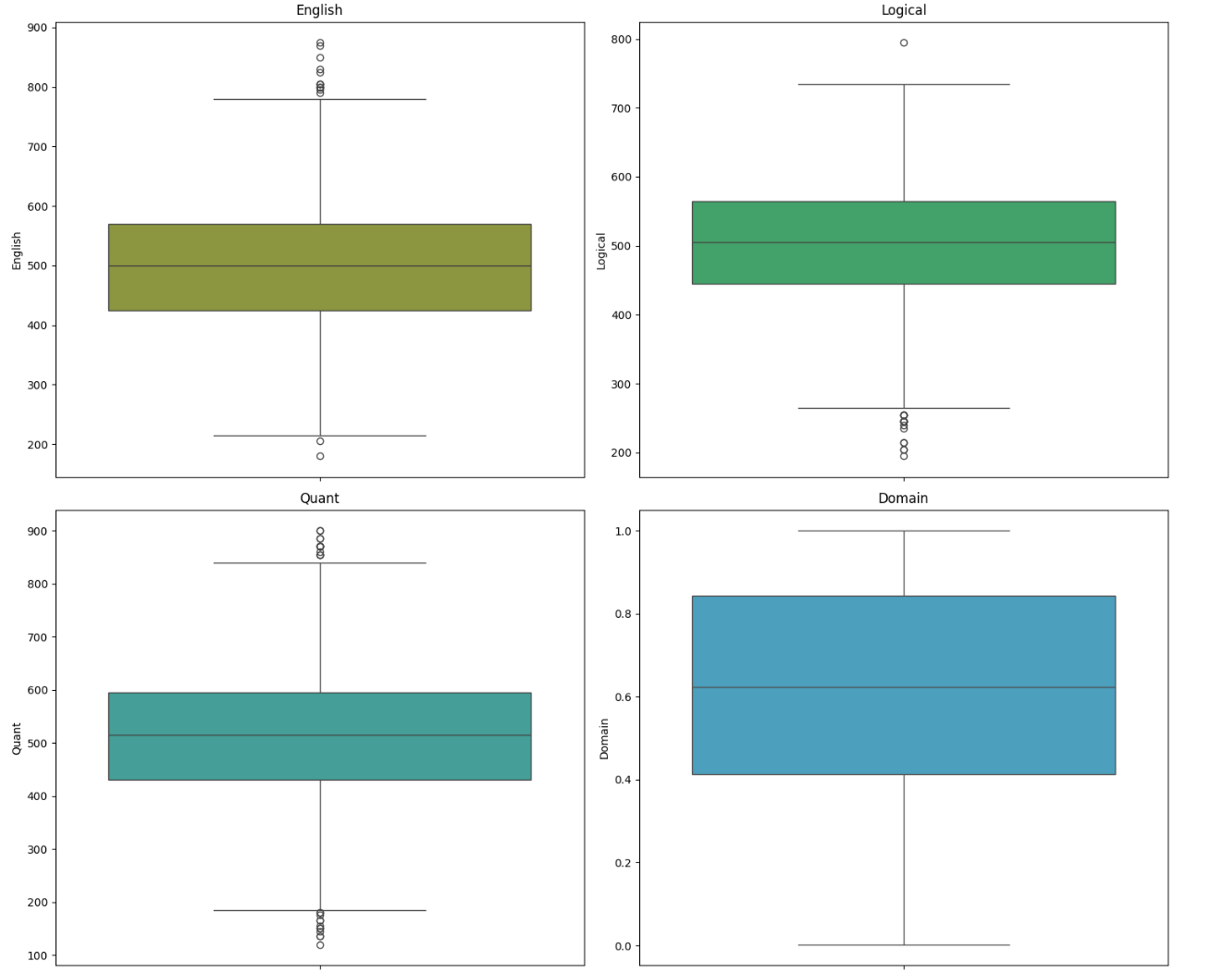

Slide 10
4. English , Logical , Quantitative Scores:
The average scores in English , Logical , Quantitative sections of the AMCAT exam are approximately 502,502, and 513, respectively.
Most , engineering graduates scored between 425 and 570 in the English section,445 and 565 in Logical section and 430 and 565 in Quants.
Overall, most candidates performed moderately well in these sections.
5. Domain Score:
The domain scores, representing the overall performance in various skill areas , have no outliers according to the IQR method.
The average domain score is around 1 , indicating a moderate level of proficiency.

Slide 11
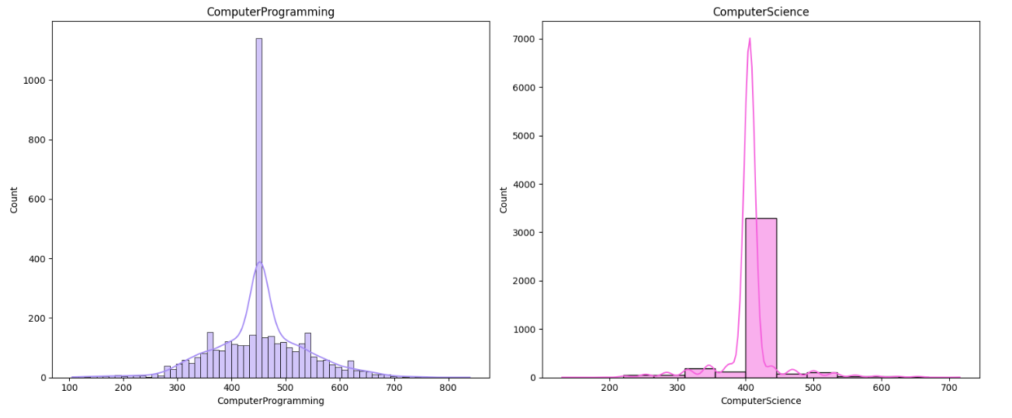
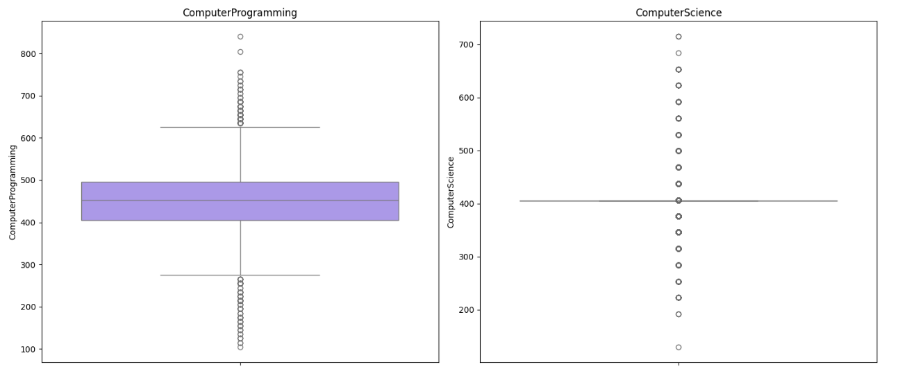

Slide 12
6. Computer Programming Scores:
The Computer Programming scores range from 105 to 840 , with an average score around 452 and a standard deviation of approximately 86 suggesting there is considerable variability in scores.
There are significant number of outliers , with values below 270 and above 630. These outliers may represent candidates with exceptional programming skills or those who struggled significantly in this area.
7. Computer Science Scores:
The Computer Science scores range from 130 to 715 , with an average score around 406 and a standard deviation of approximately 43 suggesting there is less variability in scores compared to computer programming scores.
There are outliers with values below 409 and above 474 .These outliers indicate candidates with exceptionally low or high performance in computer science relative to the majority.

Slide 13
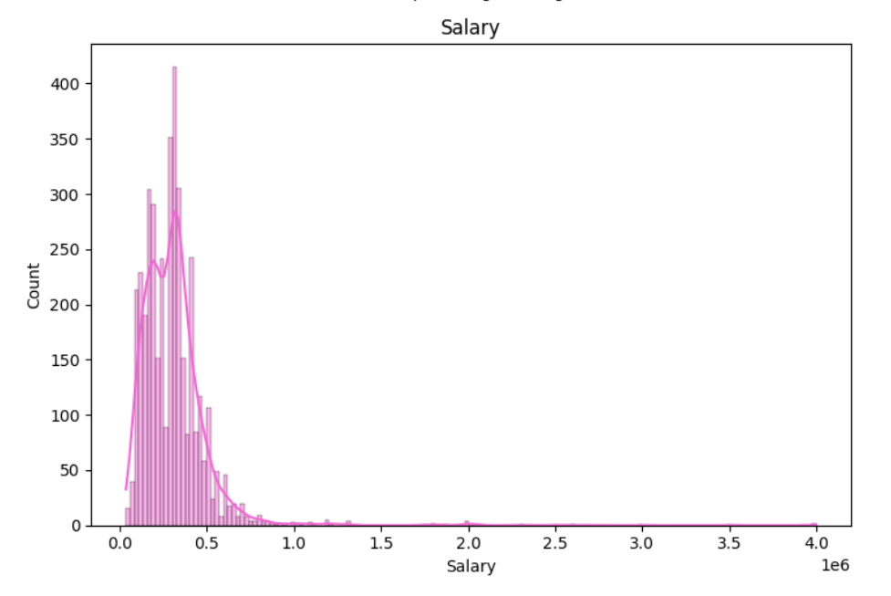
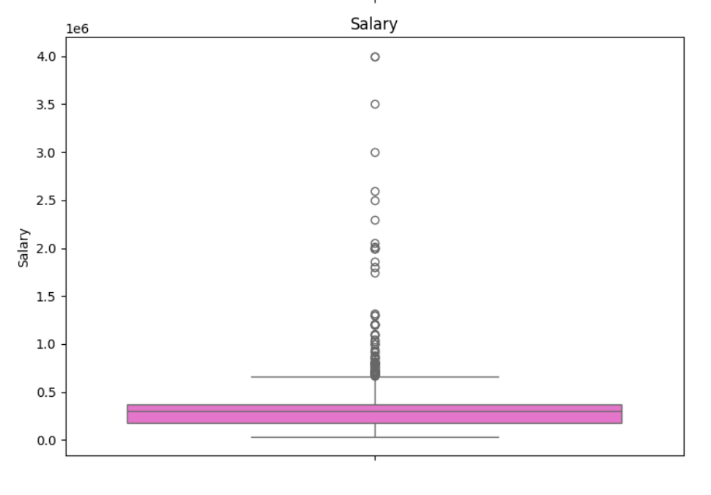

Slide 14
8. Salary:
The Salary distribution among engineering graduates shows a wide range, with salaries ranging from 35,000 INR to 4,000,000 INR.
The average salary offered to engineering r=graduates is approximately 308,256 INR, with a standard deviation of 211,763 INR.
The presence of outliers is observed, with 104 data points falling above the upper bound. These outliers may represent usually high salary offers compared to the majority of the data.

Slide 15
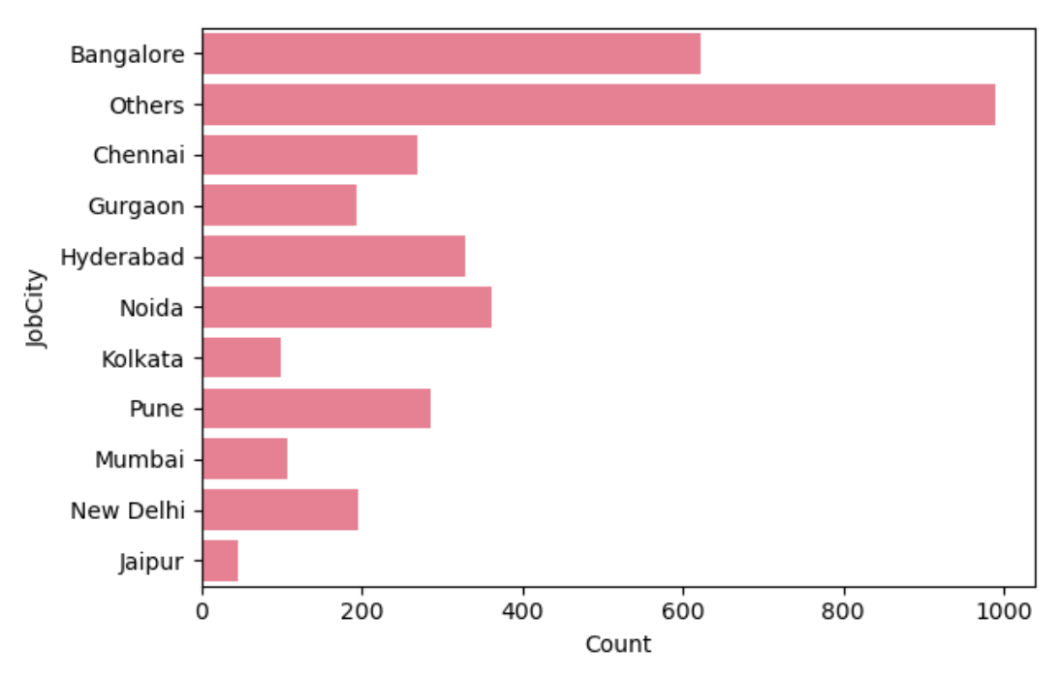
UNIVARIATE ANALYSIS ON CATEGORICAL COLUMNS:
1. JobCity
The majority of engineering graduates are employed in metropolitan cities such as Bangalore, Noida, Hyderabad, and Pune.
Around 21% of the data falls under the category "others" , indicating a diverse range of job locations.

Slide 16
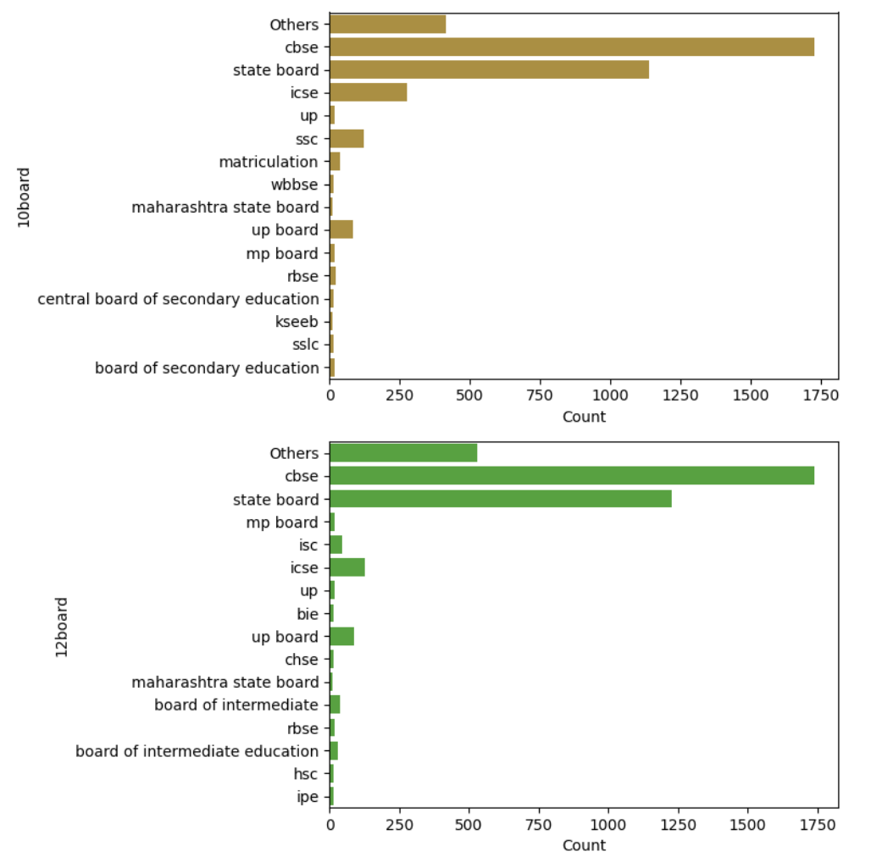
2. 10th board and 12th board

Slide 17
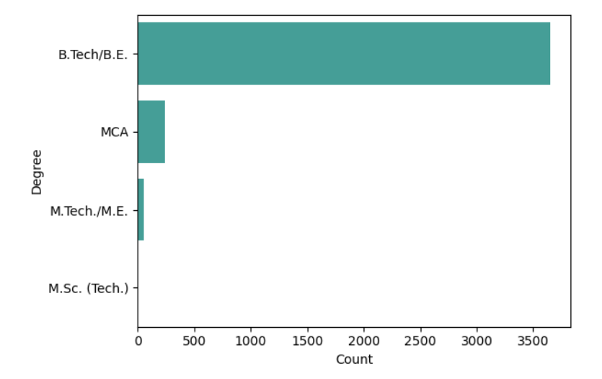
OBSERVATIONS:
Most candidates completed their 10th and 12th education under the CBSE and state boards.
A significant portion of the data falls under the ‘others’ category which includes various other educational backgrounds.
The distribution of candidates across different board suggests a diverse educational backgrounds.
3.Degree:

Slide 18
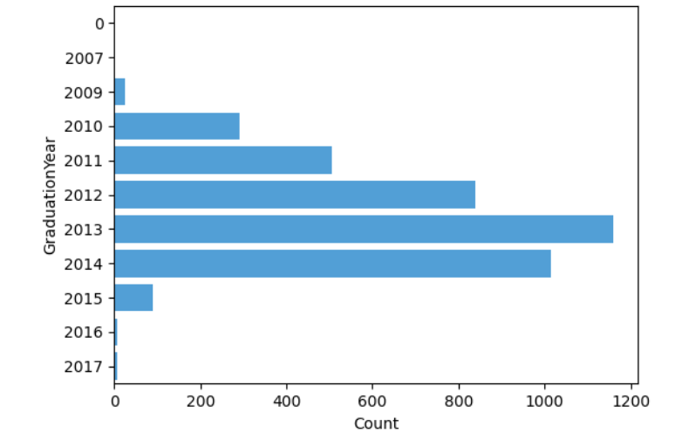
OBSERVATIONS:
The vast majority of candidates pursued a Bachelor of Technology (B.TECH/B.E.)
A small percentage of candidates pursued other degrees such as MCA , M.Tech. /M.E. and M.Sc.(Tech.).
4. Graduation Year:
The most common graduation years are 2013 and 2014.
There is small number of graduates from earlier years, such as 2007 and 2009, indicating a more recent dataset.

Slide 19
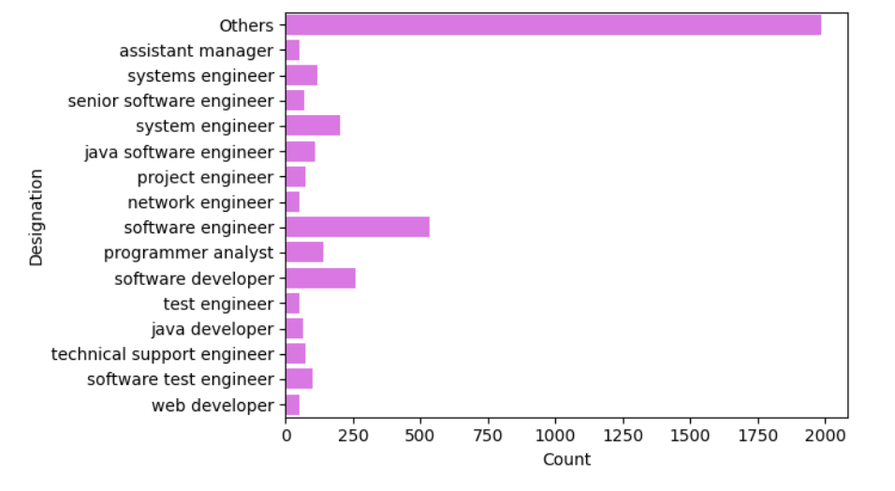
5. Designation:
The most common designation among engineering graduates is "Software Engineer", followed by "Software Developer" and "System Engineer".
The "Others“ category encompasses a wide range of designations, suggesting diversity in job roles and responsibilities.
This indicates that engineering graduates are employed in various roles across different sectors, primarily in the software industry.

Slide 20
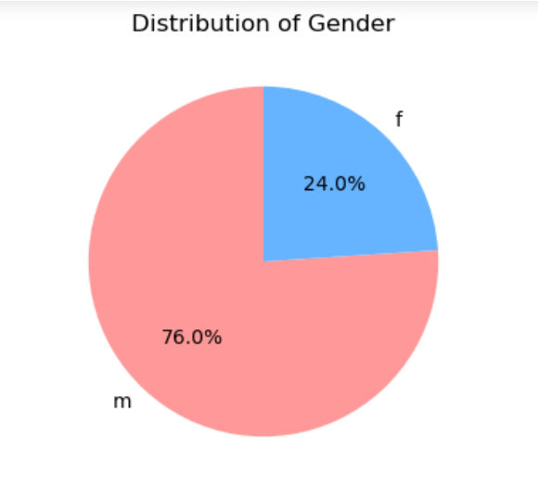
6.Gender:
There are significantly more male (2998) engineering graduates compared to female (945) engineering graduates.
This indicates a gender imbalance in the engineering field, with a higher representation of males.

Slide 21
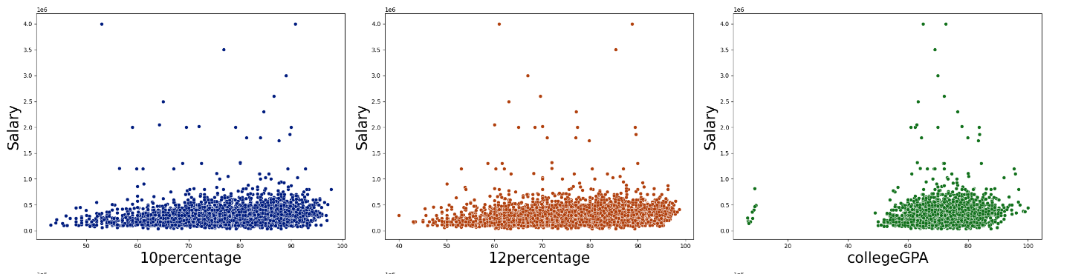
BIVARIATE ANALYSIS:
10th-grade and 12th-grade percentages exhibit moderate positive correlations with 'Salary', with coefficients of approximately 0.642 and 0.168.This suggests that higher percentages in these grades tend to be associated with higher salaries.
College GPA also shows moderate positive correlations with 'Salary', with coefficients of approximately 0.13.This indicates that candidates with higher GPAs receive slightly higher salaries.

Slide 22
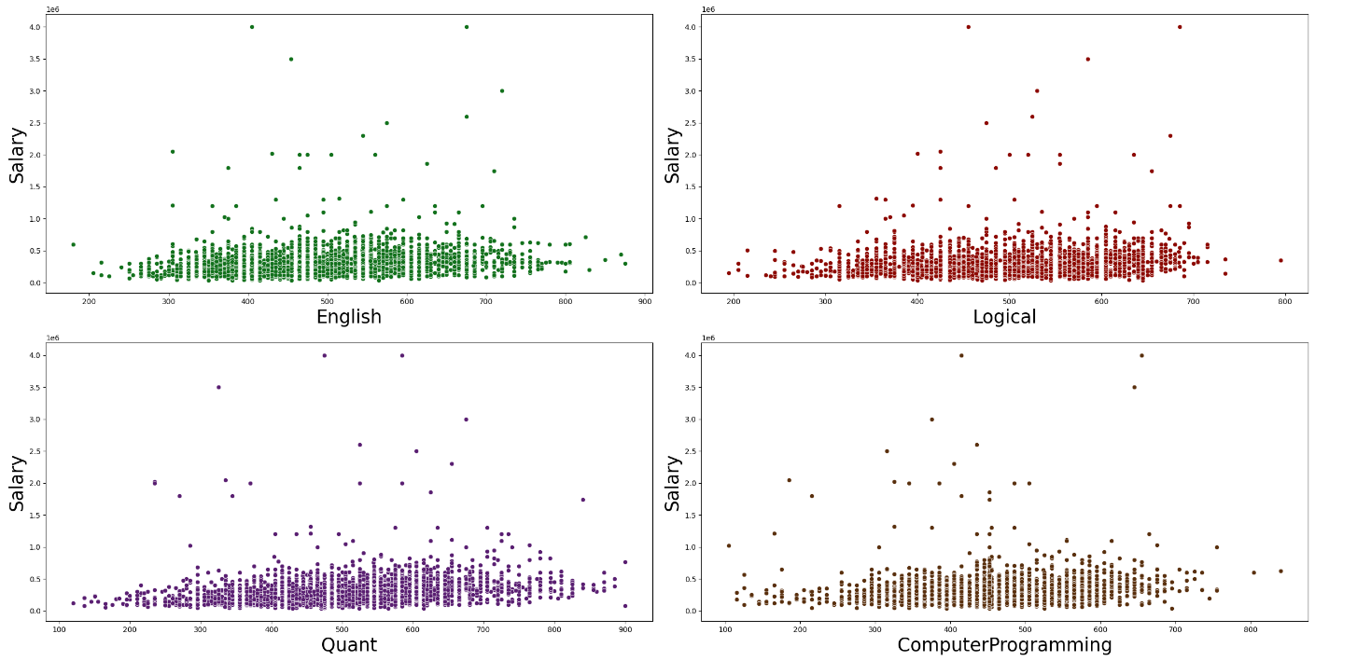
English and Logical scores have weak positive correlations with salary, with coefficients around 0.182 and 0.180 , respectively.
Quantitative scores show a slightly stronger but still weak correlation with salary, with a coefficient of approximately 0.233.
These correlations suggest that language and aptitude scores have limited predictive power for determining salary levels.
Computer programming skills exhibit a weak positive correlation with salary, with a coefficient of around 0.163.

Slide 23
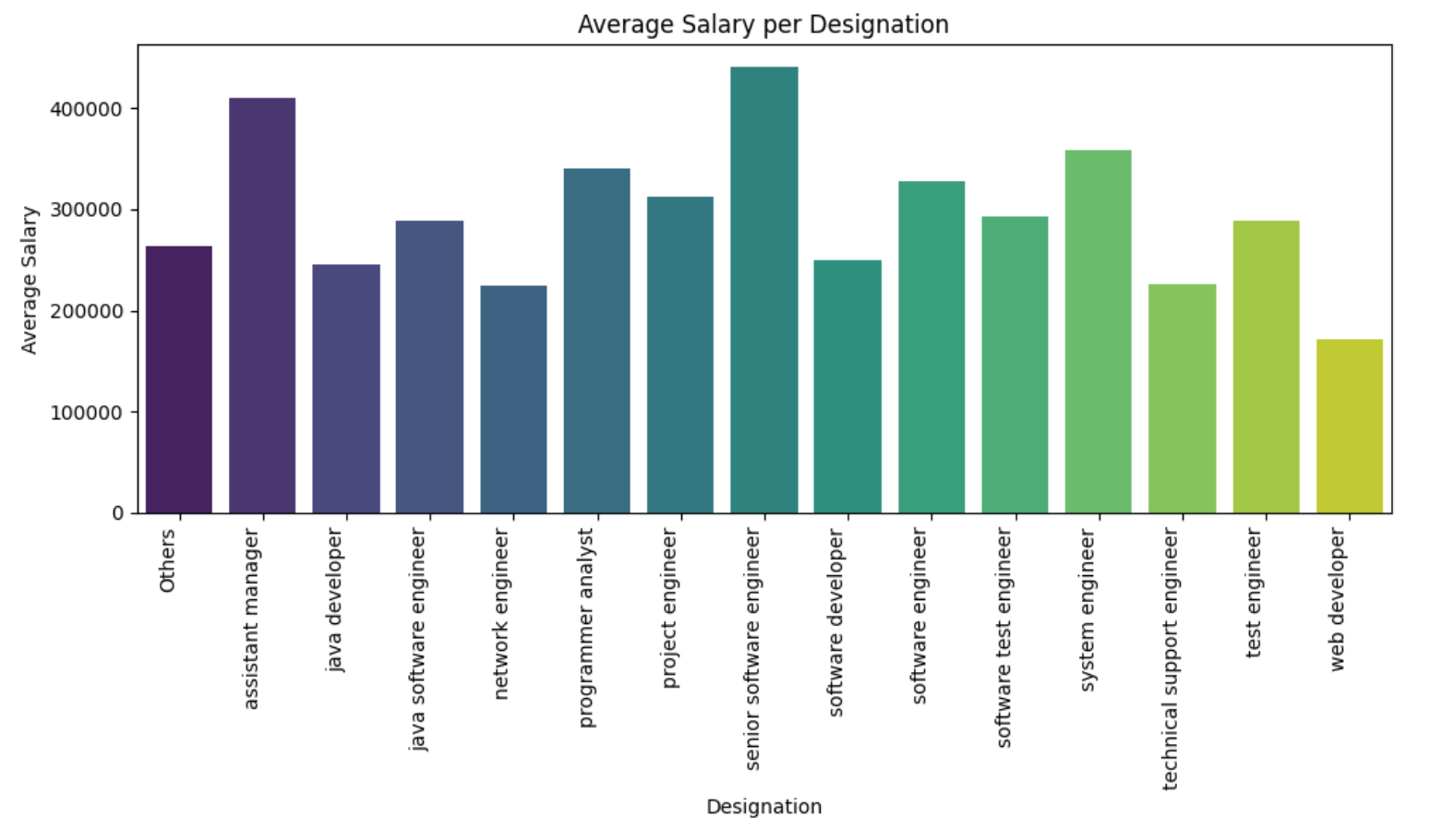
Average Salary for each Designation:
Employees with the designation "senior software engineer" have the highest mean salary, followed by "assistant manager" and "system engineer".
Employees with the designation "web developer" have the lowest mean salary among the listed designations.
There is a wide range of salaries across different designations, indicating variations in roles and responsibilities.

Slide 24
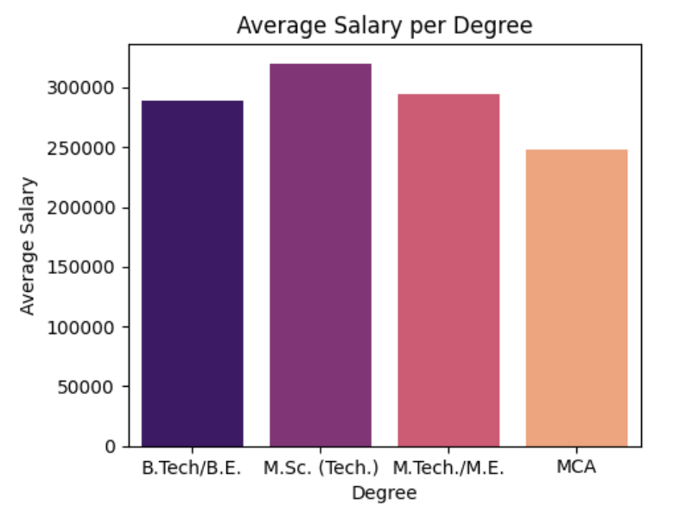
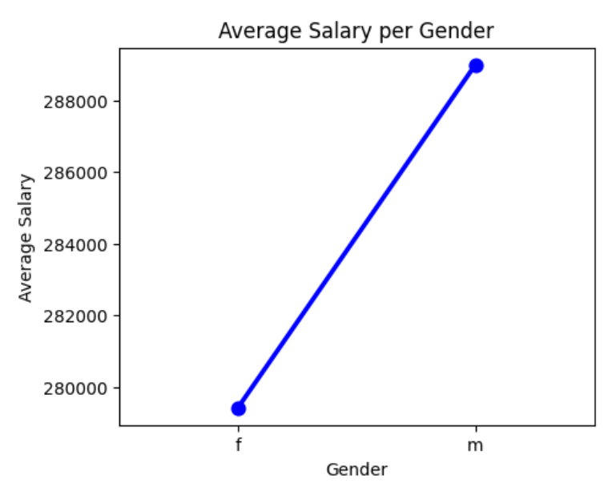
Average Salary for each Degree:
The highest mean salary is for M.Tech./M.E. degree holders, followed by B.Tech/B.E. and M.Sc. (Tech.).
MCA degree holders have a lower mean salary compared to other degrees.
Average Salary per Gender :
On average, males tend to have higher salaries compared to females…

Slide 25
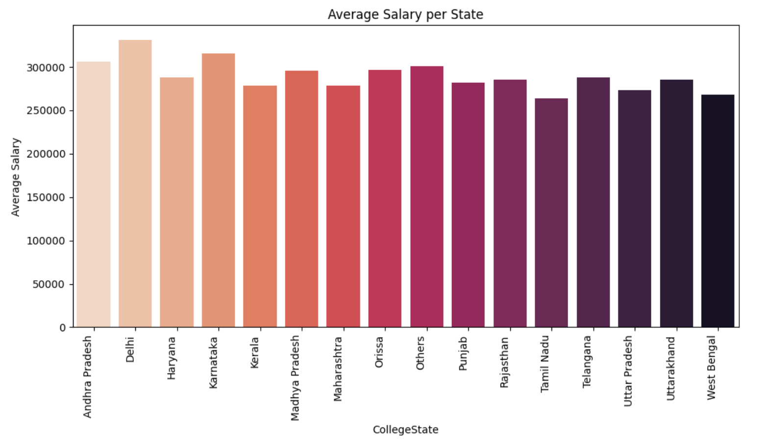
Average Salary for each State:
Delhi has the highest mean salary among the listed states, followed by Karnataka and Andhra Pradesh.
Kerala, Tamil Nadu, and West Bengal have relatively lower mean salaries compared to other states, indicating potential regional disparities in salary levels.

Slide 26
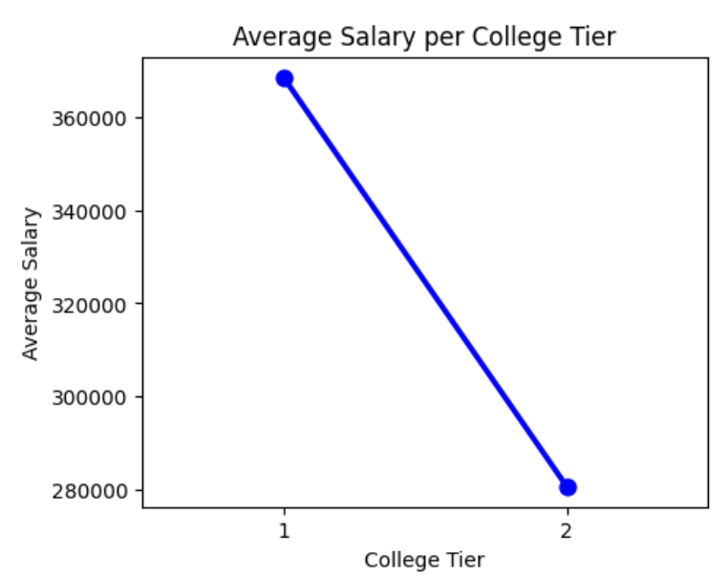
Average Salary per College Tier:
Tier 1 colleges have a higher average and median salary compared to those from Tier 2 colleges.
Additionally, Tier 2 colleges have a wider salary range from a minimum of 35,000 to a maximum of 660,000 with a larger count of candidates.
This indicates that while Tier1 college graduates tend to earn more on average, Tier 2 colleges have a wider range of salary outcomes, possibly reflecting a wider diversity of educational backgrounds and skillsets among their graduates.

Slide 27
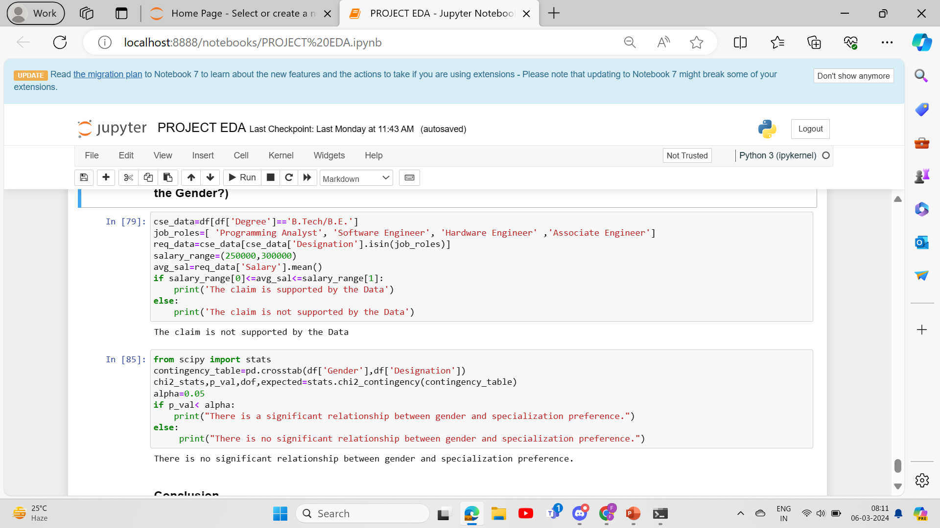
Research Questions:
Times of India article dated Jan 18, 2019 states that “After doing your Computer Science Engineering if you take up jobs as a Programming Analyst, Software Engineer, Hardware Engineer and Associate Engineer you can earn up to 2.5-3 lakhs as a fresh graduate.” Test this claim with the data given to you.
Is there a relationship between gender and specialization? (i.e. Does the preference of specialization depend on the Gender?)
Solution:

Slide 28
Based on the analysis, the claim suggesting a salary range of 2.5-3 lakhs for Computer Science Engineering graduates in specific job roles is not supported by the data. Additionally, the statistical test results indicate that there is no significant relationship between gender and specialization preference among graduates, as per the AMCAT dataset.

Slide 29
CONCLUSIONS:
From the data provided by A spiring Mind Employment Outcome 2015 (AMEO) , several significant conclusions can be drawn . Firstly, in terms of academic performance, there are outliers in various metrics such as 10th and 12th percentages , college GPA, and English, Logical, and Quantitative scores, suggesting diverse educational backgrounds among candidates. Notably, there are outliers in computer programming and computer science scores as well, indicating variations in technical skills. Moreover, the salary distribution displays outliers, particularly in the highest salary range, which may indicate higher positions or exceptional talent.
Examining demographic factors, the distribution of candidates across genders shows a higher count for males, suggesting a gender imbalance in the dataset. Additionally, while the majority of candidates hold B.Tech/B.E. degrees, there are also candidates with M.Sc. (Tech.),
M.Tech./M.E., and MCA degrees, showcasing diversity in educational qualifications.
Looking at job-related factors, the average salary varies significantly across different designations, with senior software engineers commanding the highest average salary, followed by system engineers and assistant engineers. Furthermore , candidates from different college tiers and states exhibit variations in mean salaries, with candidates from tier 1 college and those from Delhi and Karnataka having higher mean salaries compared to others.
Overall this project’s insights highlight the complexity of factors influencing job placement and salary outcomes, including educational background, technical skills, demographic attributes, and geographic location.

Slide 30

THANK YOU

